Slide 1


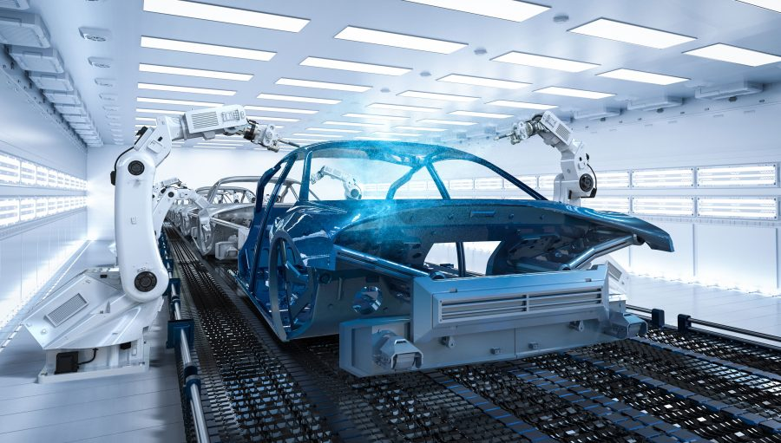
Project: Magician
Status Update

Slide 2

Work Status Update for the Project Magician
Key Points:
A brief know abouts regarding the 6-Axis FT sensor.
Modelling a Suitable handle for the Sanding Tool.
Upgrade and Corrections in the designing of the handle.
Initial 3D print models for Initial Trails.
Current On-going work.

Slide 3
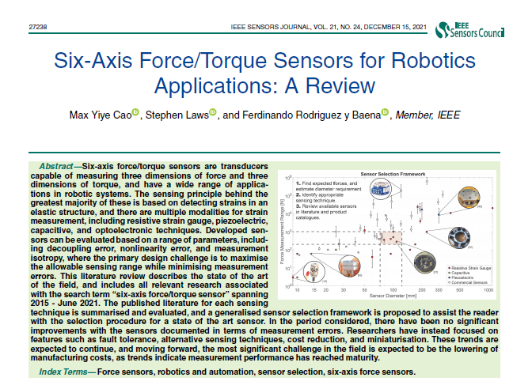
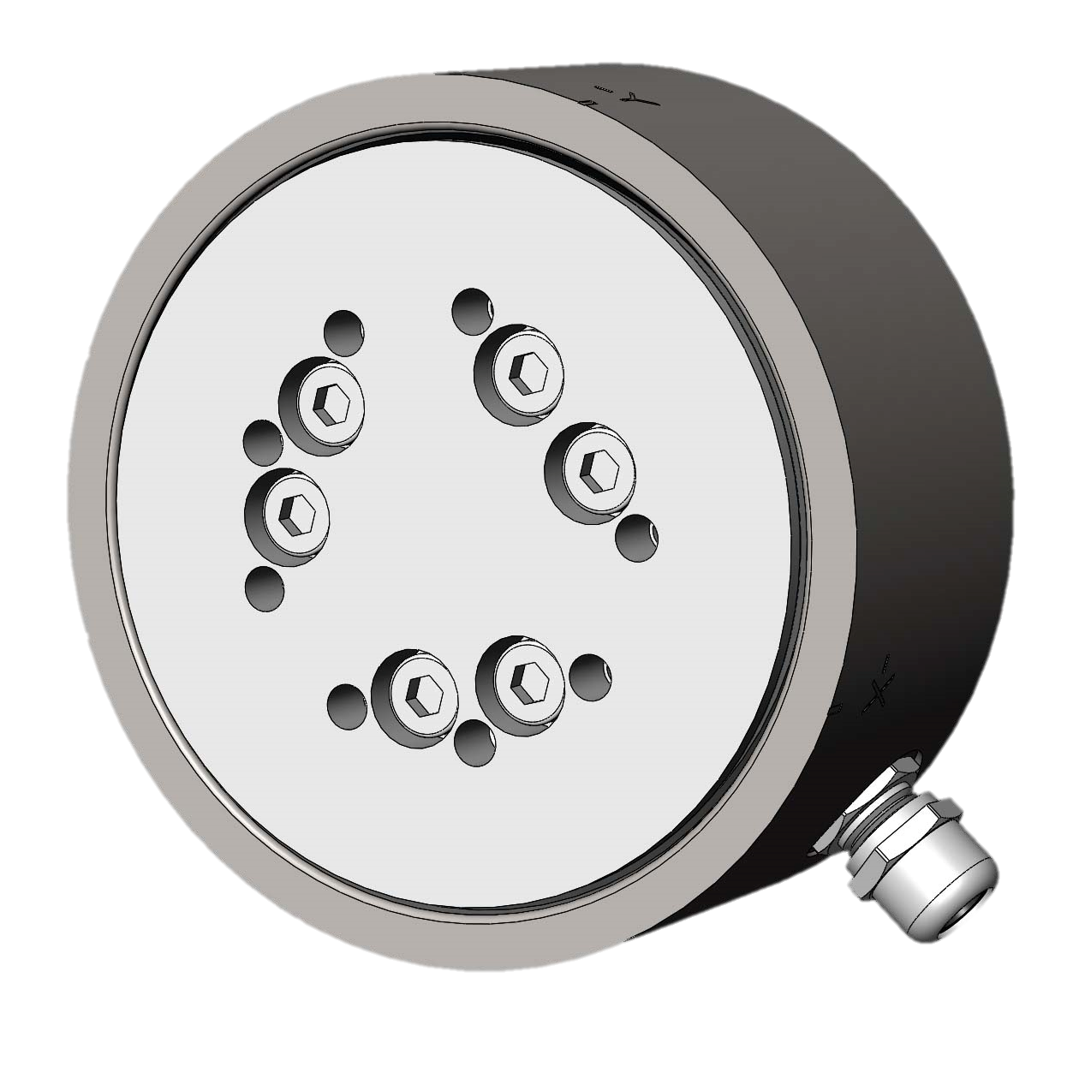
Work Status Update for the Project Magician
A brief know abouts regarding the 6-Axis FT sensor:
Did a brief Research and study regarding the charactersistics and properties regarding FT sensor and its varients.
Understood the key roles of this sensor in Robot manipulation and sensing (such as determining of forces and torques for measuring compression and tensile forces on elastic materials.
Collected required dimensions of the Sensor( Mini-45) and its datasheet.

Slide 4

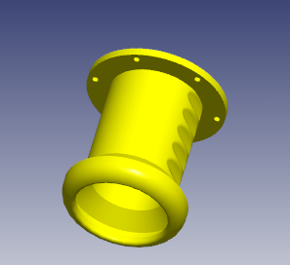
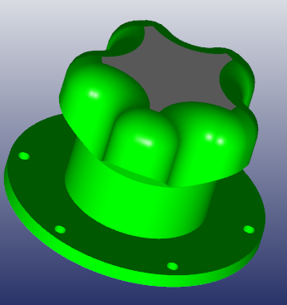
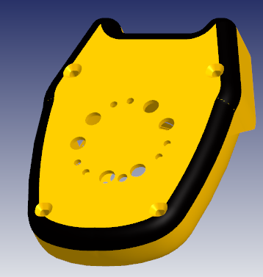
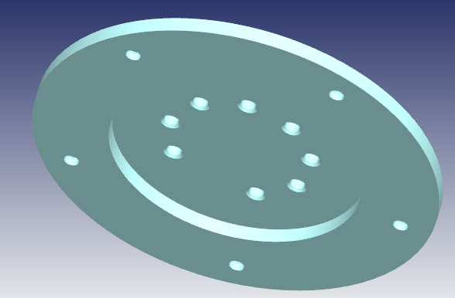
Work Status Update for the Project Magician
Modelling a Suitable handle for the Sanding Tool:
Modelled few versions for an appropriate suitable handle design for the Orbital Random sander ( Dewalt DCW210) for the initial manual sanding process.

Slide 5
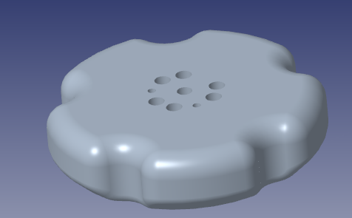
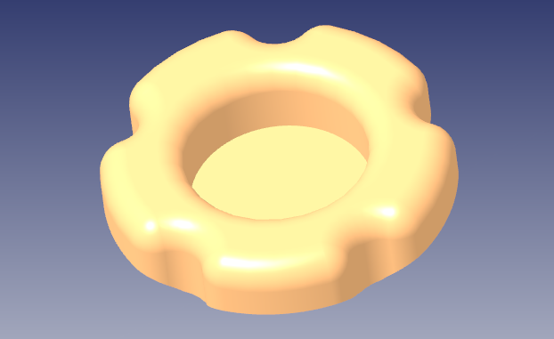
Work Status Update for the Project Magician
Upgrade and Corrections in the designing of the handle:
With the Guidance and suggestions from the Technical personals. I did some modifications and upgrades for some of the components for the handle

Slide 6
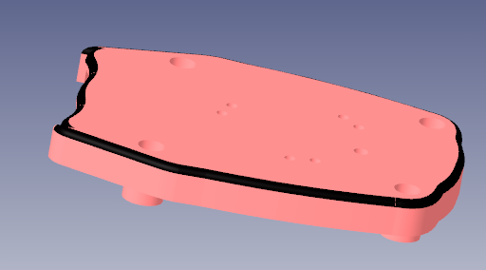
Work Status Update for the Project Magician
Upgrade and Corrections in the designing of the handle:
With the Guidance and suggestions from the Technical personals. I did some modifications and upgrades for some of the components for the handle

Slide 7
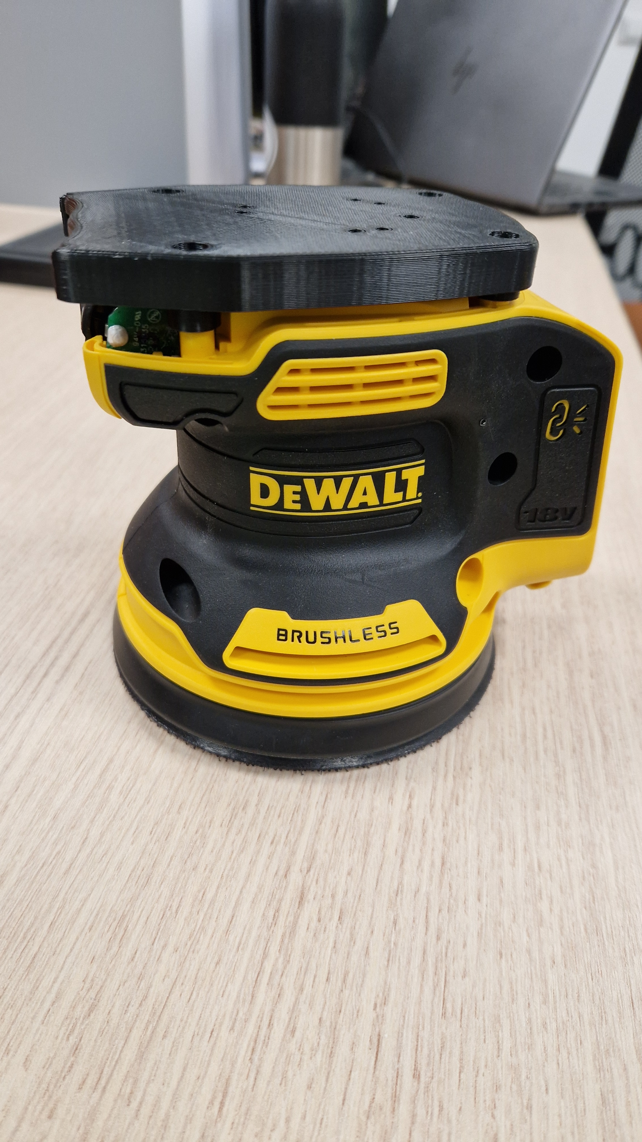
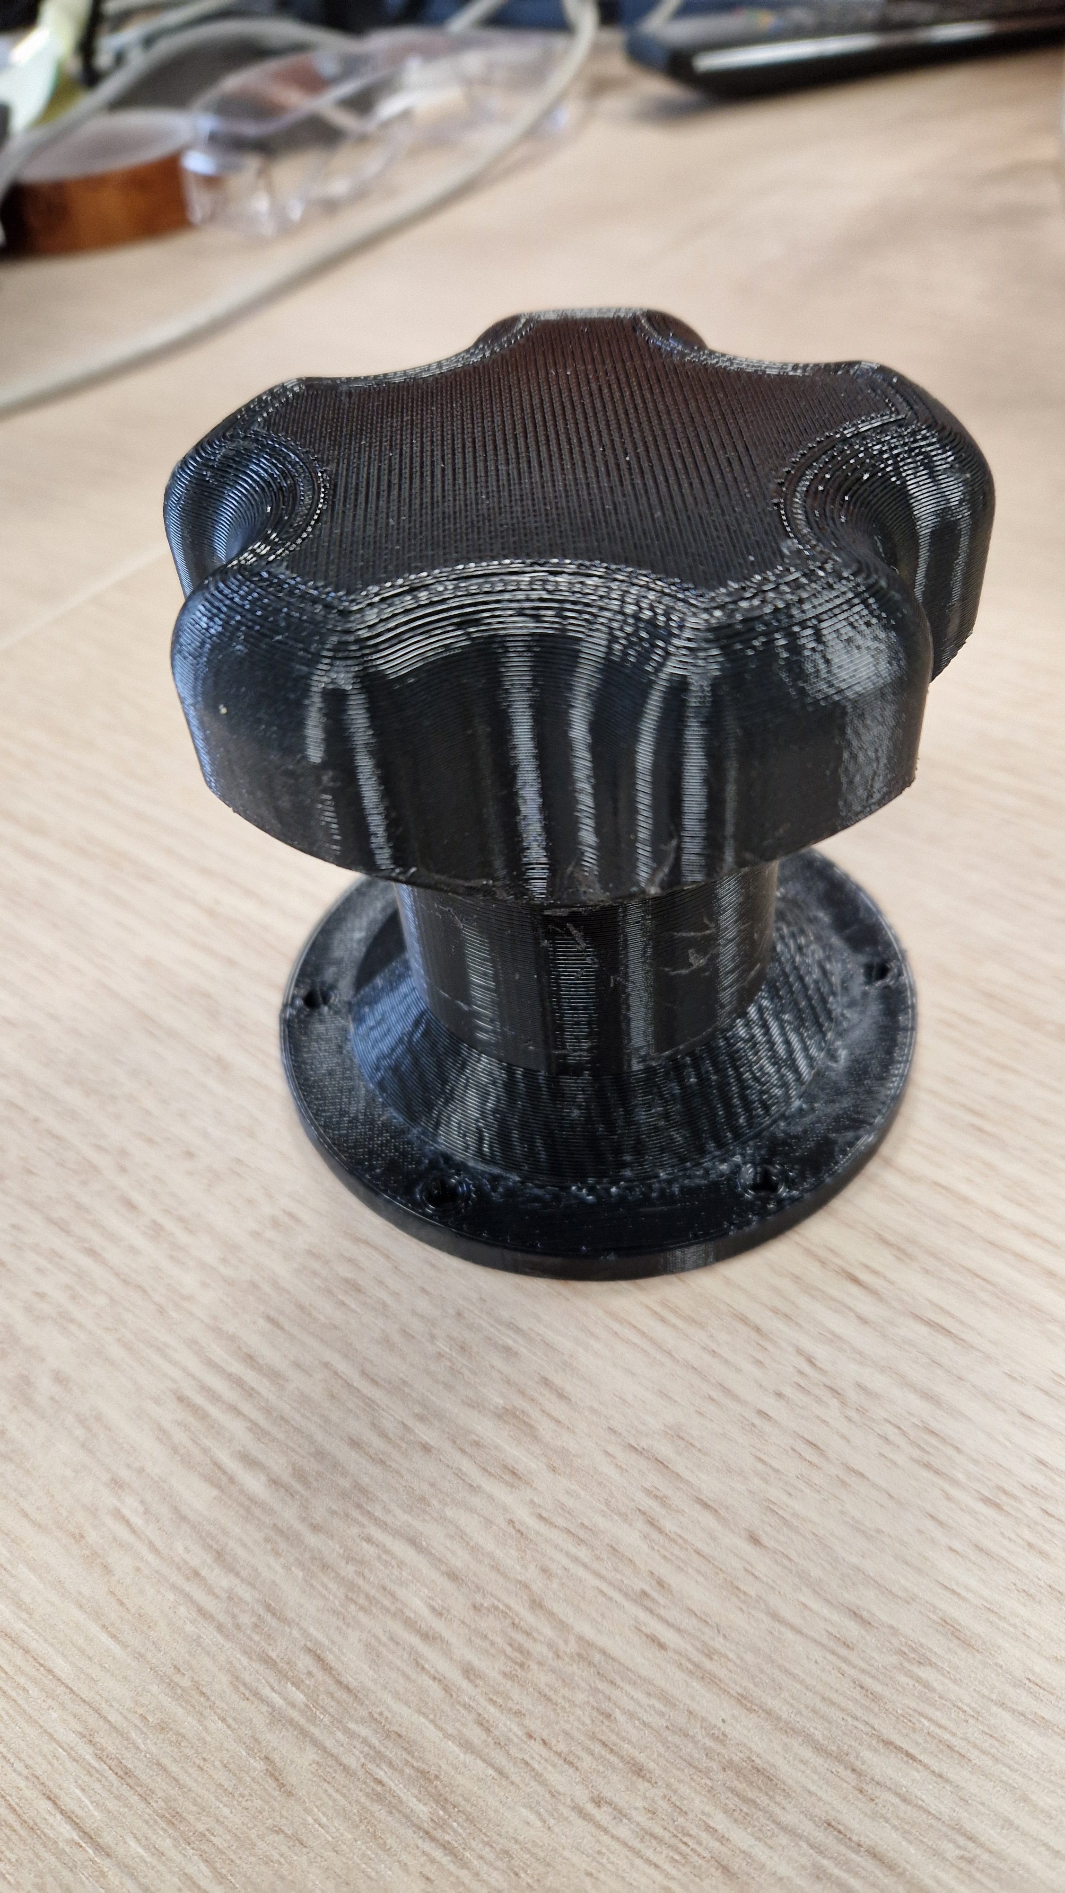
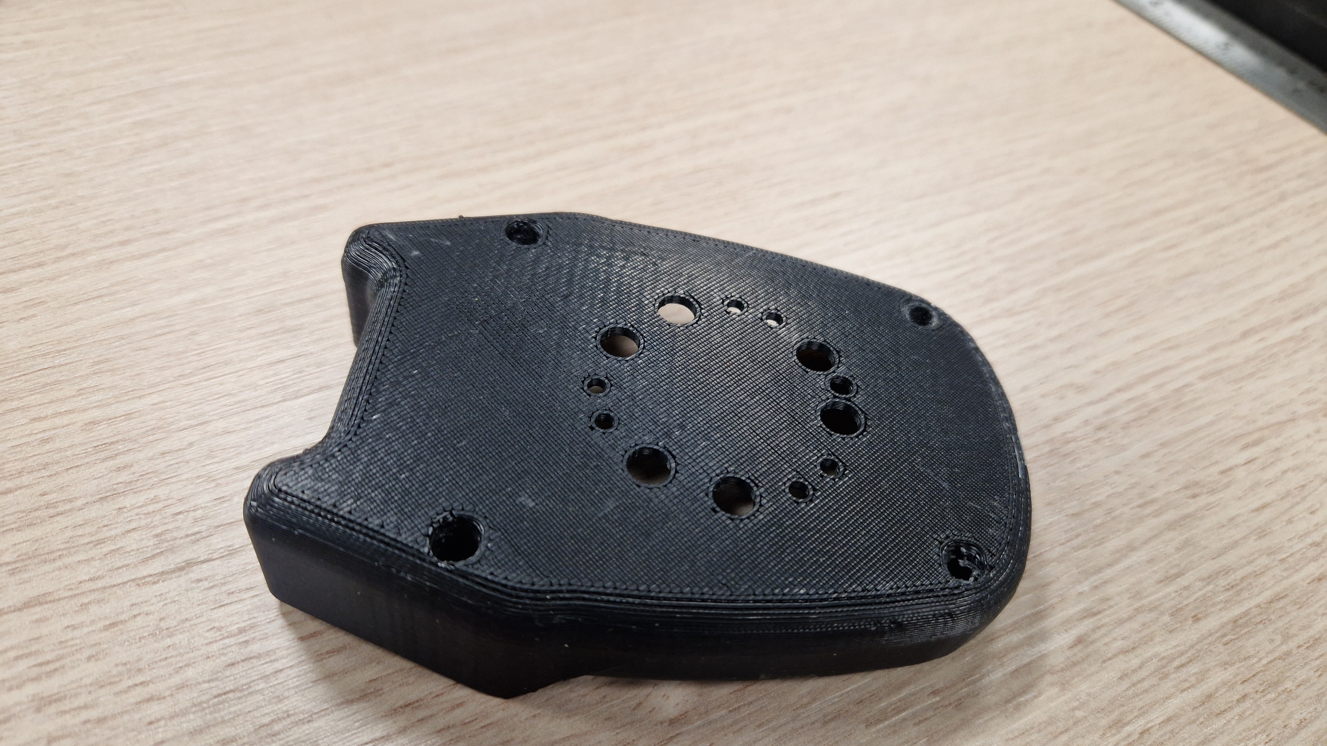
Work Status Update for the Project Magician
Initial 3D print models for Initial Trails:
Obtained Initial 3d print model to check for the correct fit and tolerances.

Slide 8
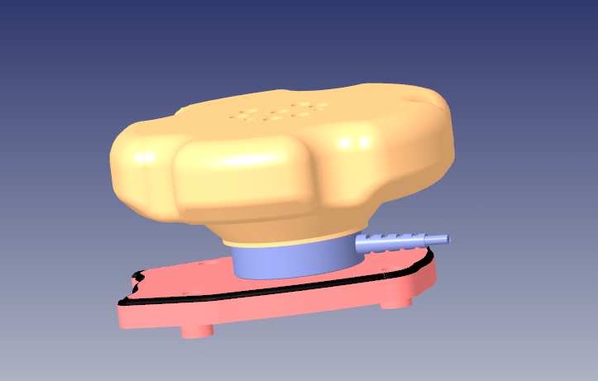
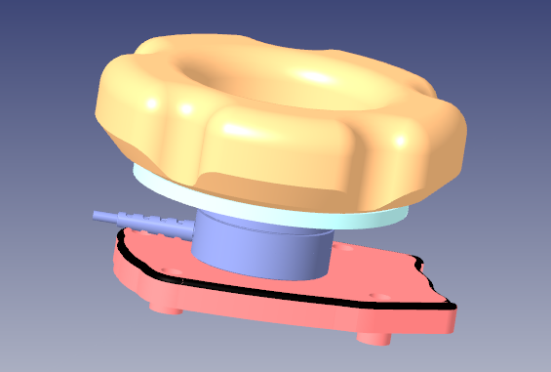
Work Status Update for the Project Magician
Current On-going work:
I just recently completed Assembling the top part of the handle of the tool with all the components in place.
In the upcoming week I will try to get the 3d models printed and assembled so that It will be ready for the Experimental setup for human trails.

Slide 9

Work Status Update for the Project Magician
Thank you very much for your patience and Understanding

